Slide 1

Project Title - Seasonal Agriculture Performance Analysis
Raashid Ahamed Nazeer Hussain –
B. S. Abdur Rahman Crescent Institute Of Science And Technology
AICTE STU ID: STU684a6ad30560a1749707475

Slide 2

PROBLEM STATEMENT
(Agricultural activities are influenced by seasonal variations in environmental conditions, farming practices, resource availability and market conditions. As a result, agricultural performance may differ from one season to another. However, raw agricultural data does not clearly explain how agricultural performance changes across seasons or what patterns can be observed in different seasonal conditions. The problem is to analyze the given agricultural dataset and investigate seasonal differences in agricultural performance by identifying meaningful patterns, trends, relationships and variations within the available data.

Slide 3
Project Description
Analyze farm-level agricultural data across Kharif, Rabi and Zaid seasons. The project covers data cleaning, exploratory analysis, seasonal comparisons, crop and irrigation analysis, regional comparisons, correlation analysis and statistical testing to identify evidence-based insights for agricultural planning.

Slide 4

WHO ARE THE END USERS?
• Farmers – seasonal planning and resource decisions
• Agricultural planners – evidence-based seasonal planning
• Government/agricultural agencies – regional and seasonal monitoring
• Researchers – study environmental and production relationships
• Agribusiness organizations – resource and economic planning

Slide 5

Technology Used
Python
Google Colab / Jupyter Notebook
Pandas • NumPy • Matplotlib • SciPy
Data Cleaning • EDA • Descriptive Statistics
Spearman Correlation • Kruskal–Wallis Test • Data Visualization

Slide 6
RESULTS
Dataset: 4,000 records | 28 variables
Kharif median yield: 1.95 t/ha
Kharif median profit: ₹38,808
Zaid median profit: ₹-62,144
Top average-profit crop: Sugarcane (₹817,188)
Highest average irrigation efficiency: Rainfed (7.56 t/1,000 m³)

Slide 7
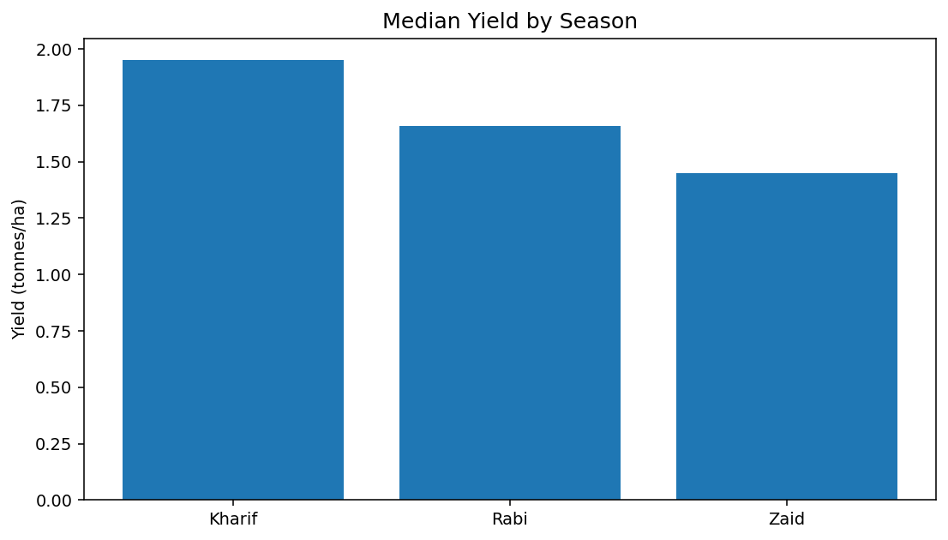
RESULTS
RESULTS – Seasonal Yield
Key takeaway: Kharif has the highest median yield (1.95 t/ha); Zaid is lowest (1.45 t/ha).

Slide 8
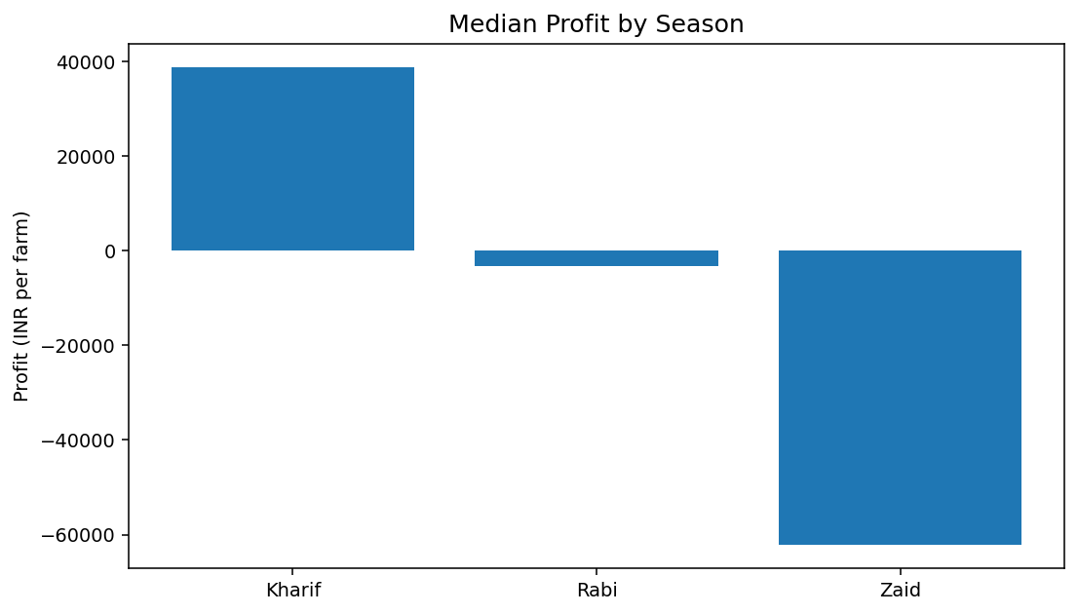
RESULTS
RESULTS – Seasonal Profit
Key takeaway: Kharif has the strongest typical profit, while Zaid has a negative median profit (₹-62,144).

Slide 9
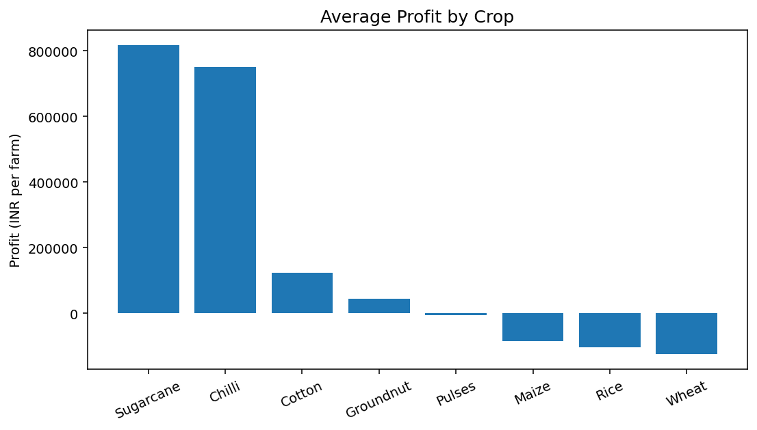
RESULTS
RESULTS – Crop Profitability
Key takeaway: Sugarcane and Chilli show the highest average profits in the supplied dataset.

Slide 10
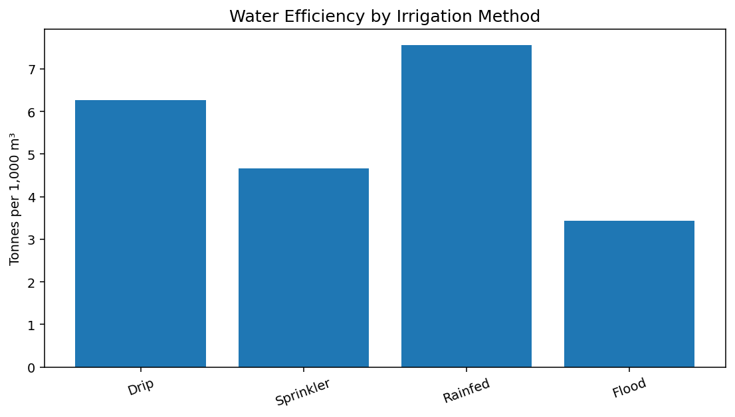
RESULTS
RESULTS – Irrigation
Key takeaway: Drip has the highest average yield and profit; Rainfed has the highest water-efficiency metric.

Slide 11
Future scope
• Add more years and real-time weather data
• Build an interactive Power BI/Tableau dashboard
• Develop crop-yield/profit prediction models
• Integrate market-price and soil-monitoring data
• Create decision-support recommendations for farmers

Slide 12
GitHub Link
https://github.com/raashidahamed/Seasonal-Agriculture-Performance-Analysis

Slide 13

VOIS Course completion certificate -
Course name – Data Visualization

Slide 14
Thank you
.
.

